Slide 1
Unit-5
Exact String Matching Algorithms Naïve Algorithm, Rabin-Karp algorithm, Knuth-Morris-Pratt algorithm.
Approximate String Matching Algorithms Levenshtein Edit distance.

Slide 2
String Matching
Introduction
Naïve Algorithm
Rabin-Karp Algorithm
Knuth-Morris-Pratt (KMP) Algorithm
Levenshtein Edit distance

Slide 3
Introduction
What is string matching?
Finding all occurrences of a pattern in a given text (or body of text)
Many applications
While using editor/word processor/browser
Login name & password checking
Virus detection
Header analysis in data communications
DNA sequence analysis, Web search engines (e.g. Google), image analysis
Finding patterns in documents formed using a large alphabet
Word processing – search/modify/replace
Web searching - search/display

Slide 4
String-Matching Problem
The text is in an array T [1..n] of length n
The pattern is in an array P [1..m] of length m
Elements of T and P are characters from a finite alphabet ∑
E.g., ∑ = {0,1} or ∑ = {a, b, …, z}
Usually T and P are called strings of characters

Slide 5
String Matching
Text string T[0..N-1] T = “abacaabaccabacabaabb”
Pattern string P[0..M-1] P = “abacab”
Where is the first instance of P in T? T[10..15] = P[0..5]

Slide 6
String-Matching Problem …contd
We say that pattern P occurs with shift s in text T if:
0 ≤ s ≤ n-m and
T [(s+1)..(s+m)] = P [1..m]
If P occurs with shift s in T, then s is a valid shift, otherwise s is an invalid shift
String-matching problem: finding all valid shifts for a given T and P

Slide 7
Example 1
1
2
3
4
5
6
7
8
9
10
11
12
13
text T
a | b | c | a | b | a | a | b | c | a | b | a | c
s = 3
1
2
3
4
pattern P
a | b | a | a
shift s = 3 is a valid shift
(n=13, m=4 and 0 ≤ s ≤ n-m holds)

Slide 8
Example 2
1
2
3
4
pattern P
a
b
a
a
1
2
3
4
5
6
7
8
9
10
11
12
13
text T
a | b | c | a | b | a | a | b | c | a | b | a | a
s = 3
a | b | a | a
s = 9
a
b
a
a

Slide 9
Naïve String-Matching Algorithm
Input: Text strings T [1..n] and P[1..m]
Result: All valid shifts displayed
NAÏVE-STRING-MATCHER (T, P)
n ← length[T]
m ← length[P]
for s ← 0 to n-m
if P[1..m] = T [(s+1)..(s+m)]
print “pattern occurs with shift” s

Slide 10
Naïve Algorithm
The Naïve algorithm consists of checking, at all the positions in the text between 0 to n-m, whether an occurrence of the pattern starts there or not.
After each attempt, it shifts the pattern by exactly one position to the right.
Example (from left to right):
a b c a b c a
a b c a (shift = 0)
a b c a (shift = 1)
a b c a (shift = 2)
a b c a (shift = 3)

Slide 11
Analysis: Worst-case Example
1
2
3
4
pattern P
a
a
a
b
1
2
3
4
5
6
7
8
9
10
11
12
13
text T
a | a | a | a | a | a | a | a | a | a | a | a | a
a
a
a
b
a
a
a
b

Slide 12
Worst-case Analysis
There are m comparisons for each shift in the worst case
There are n-m+1 shifts
So, the worst-case running time is Θ((n-m+1)m)
In the example on previous slide, we have ((13-4+1).4) =40 comparisons in total
Naïve method is inefficient because information from a shift is not used again

Slide 13
Analysis of Naïve Text Search
Worst-case:
Outer loop: n – m
Inner loop: m
Total (n–m)m = O(nm)
What is the input the gives this worst-case behavior?
Best-case: n-m
When?
Completely random text and pattern:
O(n–m)

Slide 14
String Matching
Brute force worst case
O(MN)
Expensive for long patterns in repetitive text
How to improve on this?
Intuition:
Don’t look at the text more than once.
Remember what is learned from previous matches

Slide 15
Rabin-Karp Algorithm
Has a worst-case running time of O((n-m+1)m), but average-case is O(n+m)
Also works well in practice
Based on number-theoretic notion of modular equivalence
We assume that ∑ = {0,1, 2, …, 9}, i.e., each character is a decimal digit
In general, use radix-d where d = |∑|

Slide 16
Rabin-Karp Approach
We can view a string of k characters (digits) as a length-k decimal number
E.g., the string “31425” corresponds to the decimal number 31,425
Given a pattern P [1..m], let p denote the corresponding decimal value
Given a text T [1..n], let t_{s} denote the decimal value of the length-m substring T [(s+1)..(s+m)] for s=0,1,…,(n-m)

Slide 17
Rabin-Karp Algorithm
Map a string to an integer value
2. Use a HASH function which takes a string ‘s’ and maps it to an integer H(s)=x. ‘x’ is the hash value of s
3. One of the simplest hashing functions we can use is the sum of the ASCII codes of the letters in the string
H(s[0…n-1])= int(s[0])+ int(s[1])+…….+int(s[n-1]) //ASCII code for ‘x’’
H(s[2..4]) = H(“bba”) = 98+98+97 = 293
H(s[2..4]) = H(“bab”) = 98+98+97 = 293 //Collision
4. s1 and s2 are two strings and H(s1)≠H(s2). Then we assume that s1≠s2.
If H(s1) = H(s2); we can’t guarantee that s1≠s2

Slide 18
T : ababaac P: bab
0 | 1 | 2 | 3 | 4 | 5 | 6
a | b | a | b | a | a | c
b | a | b
Hash Value of the Pattern : H(“bab”)=293 Hash Value of the Text at : Location 0: H(“aba”)=292 [97+98+97] Location 1: H(“bab”)=293 //check character by character as values match Location 2: H(“aba”)=292 Location 3: H(“baa”)=292 Location 4: H(“aac”)=293 //check character by character as values match (SUPRIOUS HIT/FALSE POSITIVE)
A better hashing function can get rid of the false-positives. Thus, It will reduce the number of locations that we need to check

Slide 19
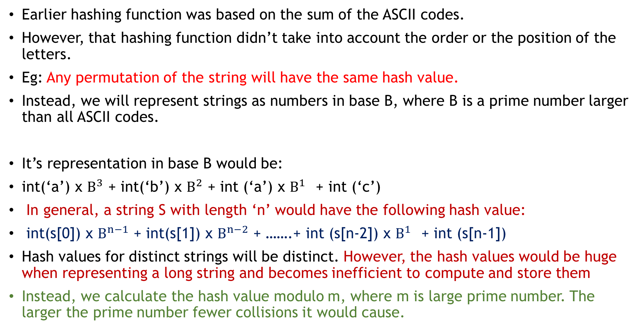
A Good Hash Function
Earlier hashing function was based on the sum of the ASCII codes.
However, that hashing function didn’t take into account the order or the position of the letters.
Eg: Any permutation of the string will have the same hash value.
Instead, we will represent strings as numbers in base B, where B is a prime number larger than all ASCII codes.
It’s representation in base B would be:
int(‘a’) x $B^{3}$ + int(‘b’) x $B^{2}$ + int (‘a’) x $B^{1 }$+ int (‘c’)
In general, a string S with length ‘n’ would have the following hash value:
int(s[0]) x $B^{n−1}$ + int(s[1]) x $B^{n−2}$ + …….+ int (s[n-2]) x $B^{1 }$+ int (s[n-1])
Hash values for distinct strings will be distinct. However, the hash values would be huge when representing a long string and becomes inefficient to compute and store them
Instead, we calculate the hash value modulo m, where m is large prime number. The larger the prime number fewer collisions it would cause.
Test: abac, n=4, strlen( “abac”)=4

Slide 20
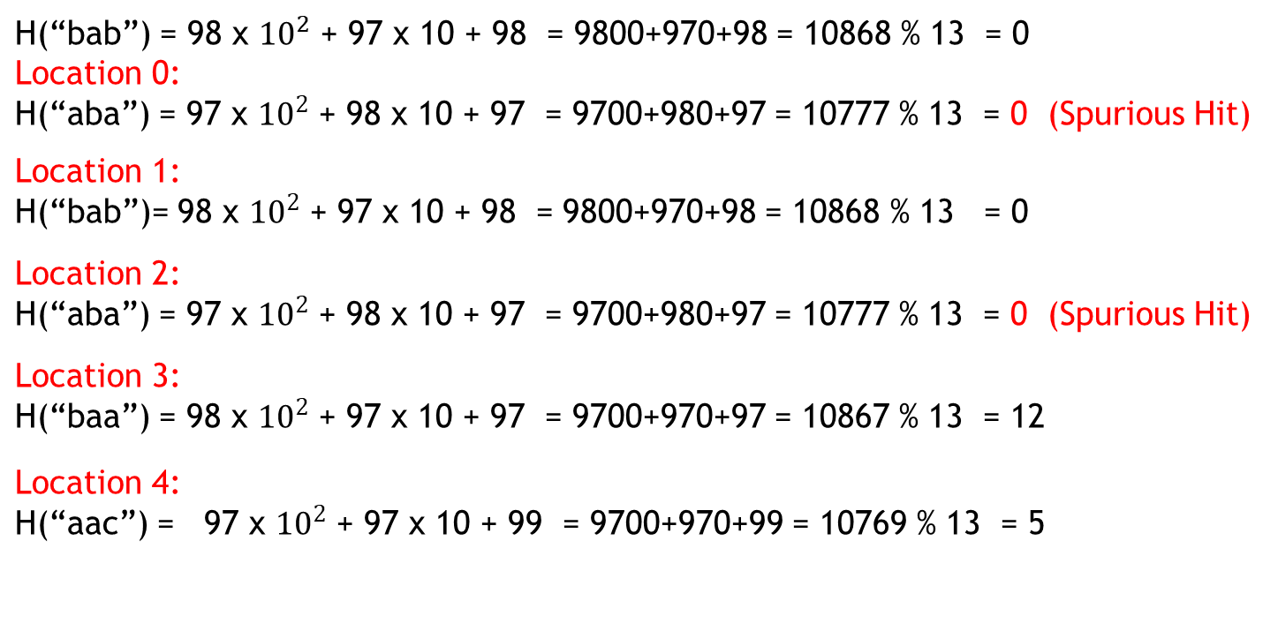
T : ababaac P: bab
0 | 1 | 2 | 3 | 4 | 5 | 6
a | b | a | b | a | a | c
b | a | b
H(“bab”) = 98 x ${10}^{2}$ + 97 x 10 + 98 = 9800+970+98 = 10868 % 13 = 0 Location 0: H(“aba”) = 97 x ${10}^{2}$ + 98 x 10 + 97 = 9700+980+97 = 10777 % 13 = 0 (Spurious Hit) Location 1: H(“bab”)= 98 x ${10}^{2}$ + 97 x 10 + 98 = 9800+970+98 = 10868 % 13 = 0 Location 2: H(“aba”) = 97 x ${10}^{2}$ + 98 x 10 + 97 = 9700+980+97 = 10777 % 13 = 0 (Spurious Hit) Location 3: H(“baa”) = 98 x ${10}^{2}$ + 97 x 10 + 97 = 9700+970+97 = 10867 % 13 = 12 Location 4: H(“aac”) = 97 x ${10}^{2}$ + 97 x 10 + 99 = 9700+970+99 = 10769 % 13 = 5
A Large Prime Number is better. The larger the prime is, fewer collisions it would cause.

Slide 21
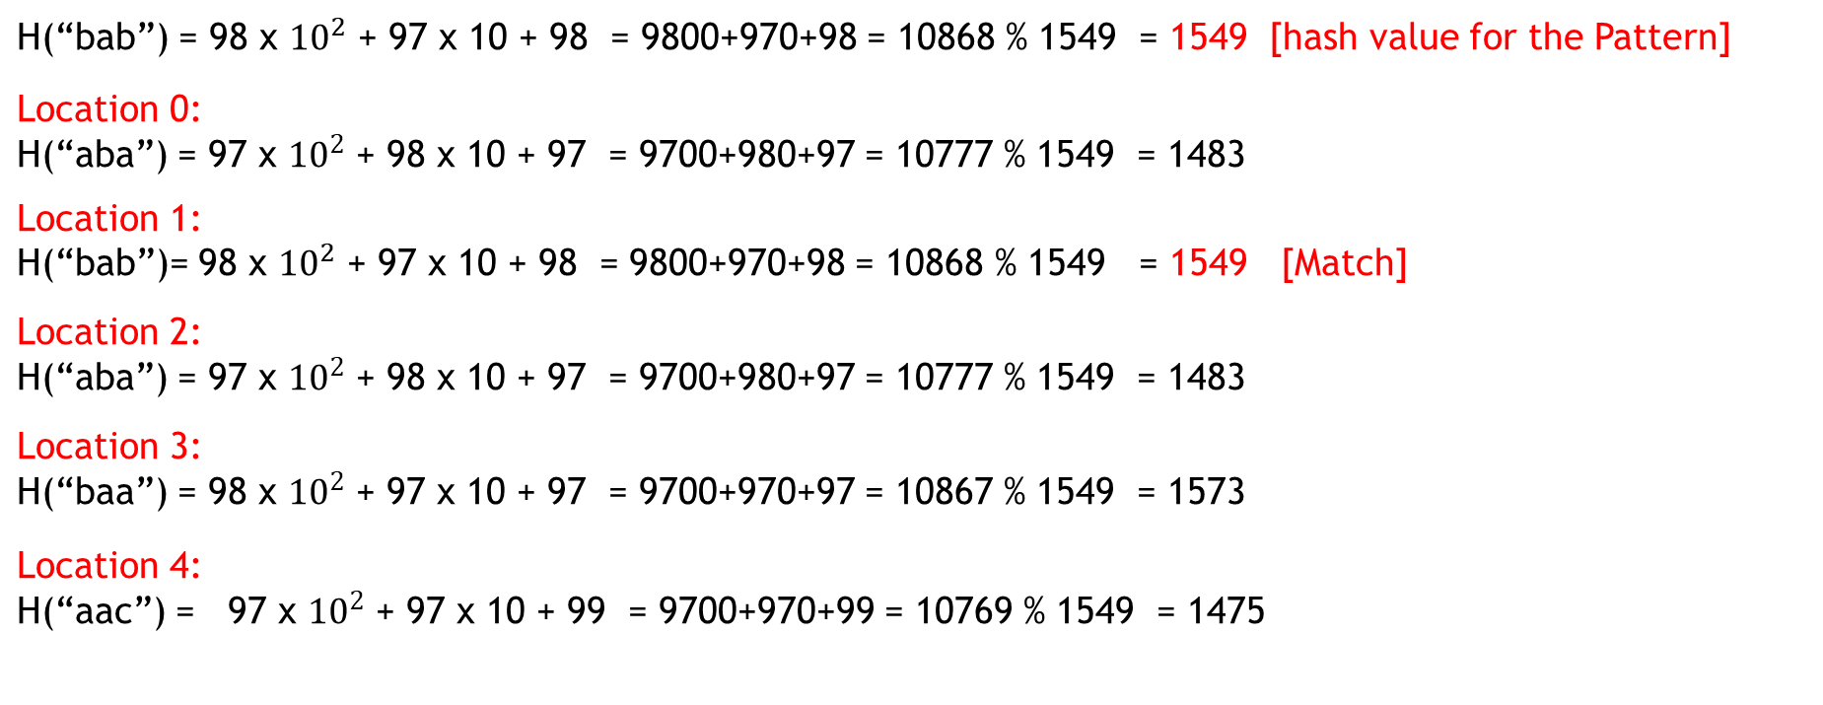
T : ababaac P: bab
0 | 1 | 2 | 3 | 4 | 5 | 6
a | b | a | b | a | a | c
b | a | b
H(“bab”) = 98 x ${10}^{2}$ + 97 x 10 + 98 = 9800+970+98 = 10868 % 1549 = 1549 [hash value for the Pattern] Location 0: H(“aba”) = 97 x ${10}^{2}$ + 98 x 10 + 97 = 9700+980+97 = 10777 % 1549 = 1483 Location 1: H(“bab”)= 98 x ${10}^{2}$ + 97 x 10 + 98 = 9800+970+98 = 10868 % 1549 = 1549 [Match] Location 2: H(“aba”) = 97 x ${10}^{2}$ + 98 x 10 + 97 = 9700+980+97 = 10777 % 1549 = 1483 Location 3: H(“baa”) = 98 x ${10}^{2}$ + 97 x 10 + 97 = 9700+970+97 = 10867 % 1549 = 1573 Location 4: H(“aac”) = 97 x ${10}^{2}$ + 97 x 10 + 99 = 9700+970+99 = 10769 % 1549 = 1475
A better hashing function can get rid of the false-positives. Thus, It will reduce the number of locations that we need to check

Slide 22
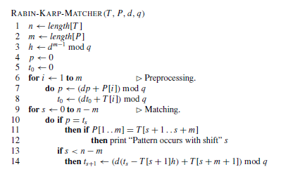
The Rabin-Karp algorithm

Slide 23
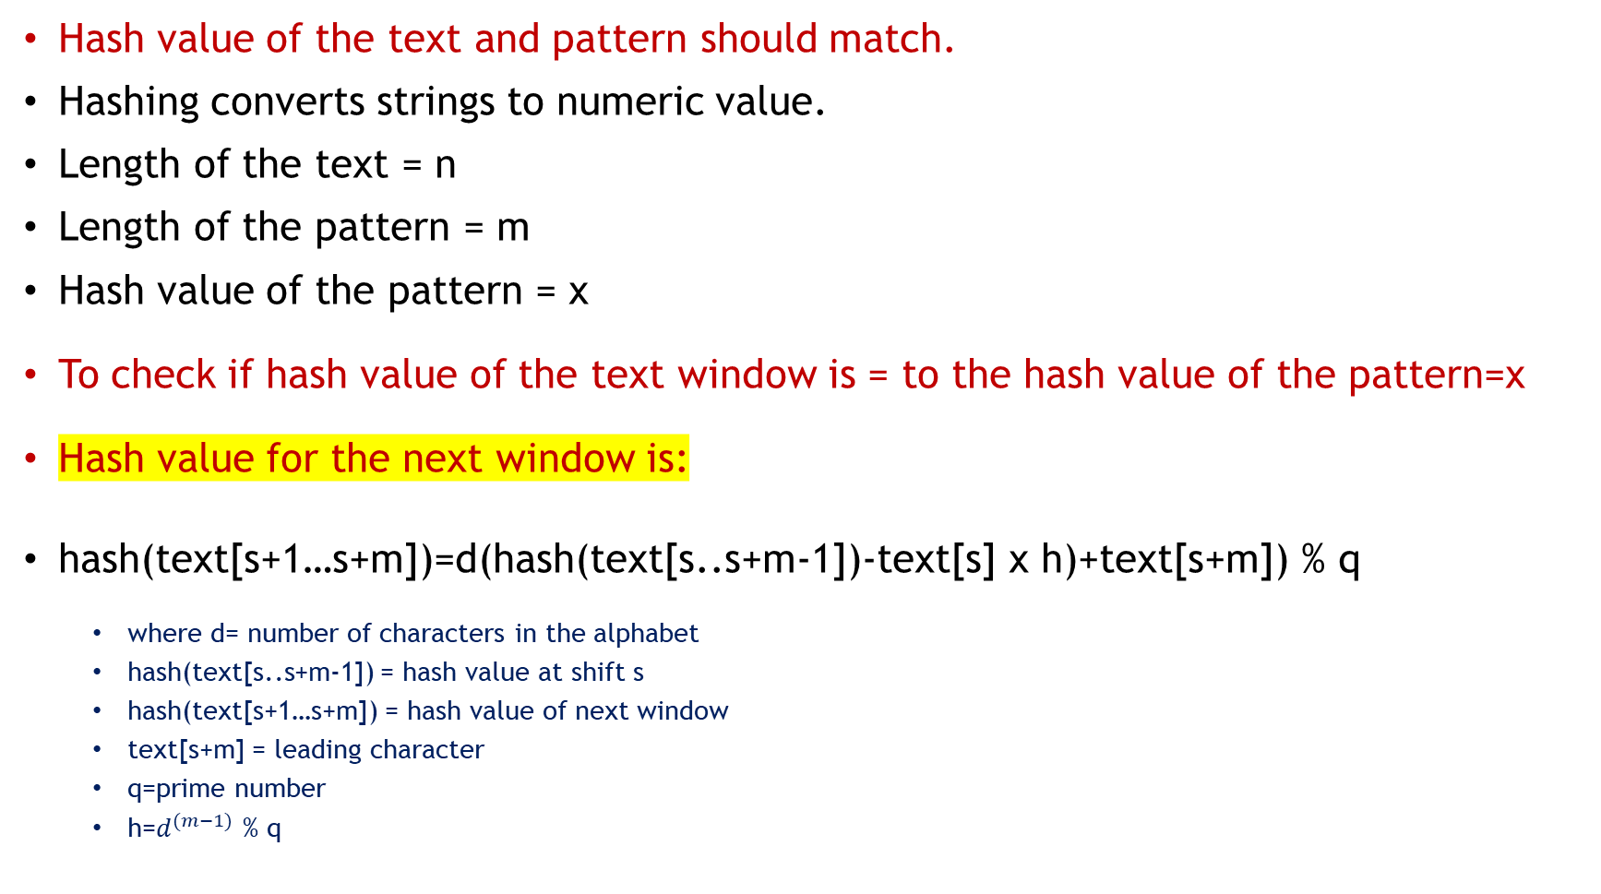
The Rabin-Karp algorithm
Hash value of the text and pattern should match.
Hashing converts strings to numeric value.
Length of the text = n
Length of the pattern = m
Hash value of the pattern = x
To check if hash value of the text window is = to the hash value of the pattern=x
Hash value for the next window is:
hash(text[s+1…s+m])=d(hash(text[s..s+m-1])-text[s] x h)+text[s+m]) % q
where d= number of characters in the alphabet
hash(text[s..s+m-1]) = hash value at shift s
hash(text[s+1…s+m]) = hash value of next window
text[s+m] = leading character
q=prime number
h=$d^{(m−1)}$ % q

Slide 24
// C++ implementation of Rabin Karp #include <bits/stdc++.h> using namespace std; #define d 256 // d is the number of characters in the input alphabet /* pat -> pattern txt -> text q -> A prime number */ void search(char pat[], char txt[], int q) { int M = strlen(pat); int N = strlen(txt); int i, j; int p = 0; // hash value for pattern int t = 0; // hash value for txt int h = 1; // The value of h would be "pow(d, M-1)%q" for (i = 0; i < M - 1; i++) h = (h * d) % q; // Calculate the hash value of pattern and first // window of text for (i = 0; i < M; i++) { p = (d * p + pat[i]) % q; t = (d * t + txt[i]) % q; } | for (i = 0; i <= N - M; i++) { // Check the hash values of current window of text // and pattern. If the hash values match then only // check for characters one by one if (p == t) { /* Check for characters one by one */ for (j = 0; j < M; j++) { if (txt[i + j] != pat[j]) { break; } } // if p == t and pat[0...M-1] = txt[i, i+1,...i+M-1] if (j == M) cout << "Pattern found at index " << i << endl; } // Calculate hash value for next window of text: // Remove leading digit, add trailing digit if (i < N - M) { t = (d * (t - txt[i] * h) + txt[i + M]) % q; // We might get negative value of t, converting it to positive if (t < 0) t = (t + q); } } }
/* Driver code */ int main() { char txt[] = “ABDCB"; char pat[] = “DC"; // we mod to avoid overflowing of value but we should take as big q as possible to avoid the collison
int q = INT_MAX; // Function Call search(pat, txt, q); return 0; }

Slide 25
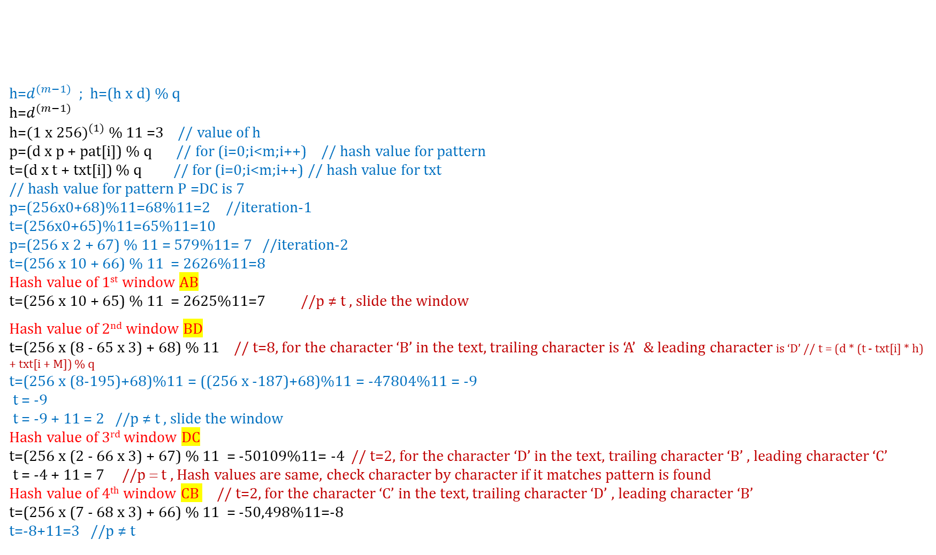
T : ABDCB P: DC
q= 11 d=256 m=2 //M = strlen(pat) n=5 //N = strlen(txt); h=1 p=0, t=0
h=$d^{(m−1)}$ ; h=(h x d) % q h=$d^{(m−1)}$ h=${(1 x 256)}^{(1)}$ % 11 =3 // value of h p=(d x p + pat[i]) % q // for (i=0;i<m;i++) // hash value for pattern t=(d x t + txt[i]) % q // for (i=0;i<m;i++) // hash value for txt // hash value for pattern P =DC is 7 p=(256x0+68)%11=68%11=2 //iteration-1 t=(256x0+65)%11=65%11=10 p=(256 x 2 + 67) % 11 = 579%11= 7 //iteration-2 t=(256 x 10 + 66) % 11 = 2626%11=8 Hash value of 1st window AB t=(256 x 10 + 65) % 11 = 2625%11=7 //p ≠ t , slide the window Hash value of 2nd window BD t=(256 x (8 - 65 x 3) + 68) % 11 // t=8, for the character ‘B’ in the text, trailing character is ‘A’ & leading character is ‘D’ // t = (d * (t - txt[i] * h) + txt[i + M]) % q t=(256 x (8-195)+68)%11 = ((256 x -187)+68)%11 = -47804%11 = -9 t = -9 t = -9 + 11 = 2 //p ≠ t , slide the window Hash value of 3rd window DC t=(256 x (2 - 66 x 3) + 67) % 11 = -50109%11= -4 // t=2, for the character ‘D’ in the text, trailing character ‘B’ , leading character ‘C’ t = -4 + 11 = 7 //p = t , Hash values are same, check character by character if it matches pattern is found Hash value of 4th window CB // t=2, for the character ‘C’ in the text, trailing character ‘D’ , leading character ‘B’ t=(256 x (7 - 68 x 3) + 66) % 11 = -50,498%11=-8 t=-8+11=3 //p ≠ t
for (i = 0; i < M; i++) { p = (d * p + pat[i]) % q; t = (d * t + txt[i]) % q; }

Slide 26

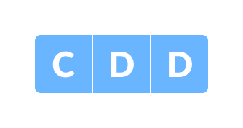
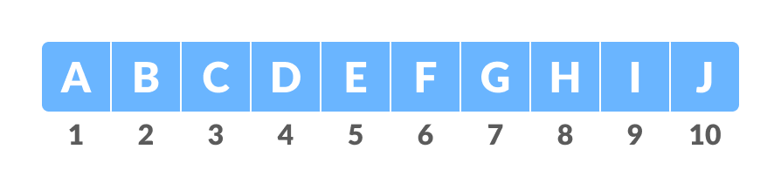
Rabin-Karp - Example 2
m = length of the pattern
n = length of the text
n=10
m=3 d =number of characters in the input set.
In this example we have input set {A, B, C, ..., J}.
Hence, d = 10.
You can assume any suitable value for d.
Text
Pattern
Let us assign a numerical value(v)/weight for the characters we will be using in the problem.
Here, we have taken first ten alphabets only (i.e. A to J).
Text Weights

Slide 27
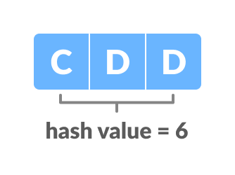
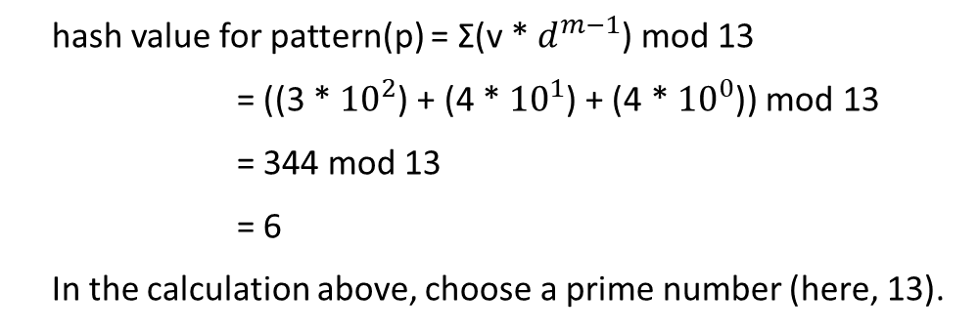
Rabin-Karp - Example 2
Hash value of the pattern
hash value for pattern(p) = Σ(v * $d^{m−1}$) mod 13
= ((3 * ${10}^{2}$) + (4 * ${10}^{1}$) + (4 * ${10}^{0}$)) mod 13
= 344 mod 13
= 6
In the calculation above, choose a prime number (here, 13).

Slide 28
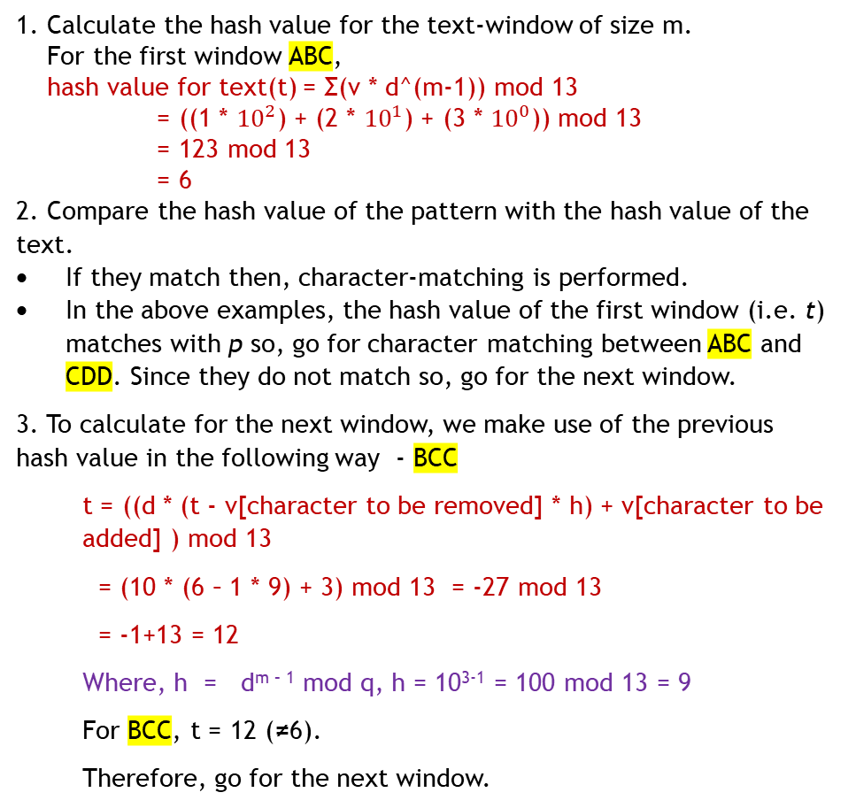
1. Calculate the hash value for the text-window of size m.
For the first window ABC,
hash value for text(t) = Σ(v * d^(m-1)) mod 13
= ((1 * ${10}^{2}$) + (2 * ${10}^{1}$) + (3 * ${10}^{0}$)) mod 13
= 123 mod 13
= 6
2. Compare the hash value of the pattern with the hash value of the text.
If they match then, character-matching is performed.
In the above examples, the hash value of the first window (i.e. t) matches with p so, go for character matching between ABC and CDD. Since they do not match so, go for the next window.
3. To calculate for the next window, we make use of the previous hash value in the following way - BCC
t = ((d * (t - v[character to be removed] * h) + v[character to be added] ) mod 13
= (10 * (6 – 1 * 9) + 3) mod 13 = -27 mod 13
= -1+13 = 12
Where, h = d^{m – 1} mod q, h = 10³⁻¹ = 100 mod 13 = 9
For BCC, t = 12 (≠6).
Therefore, go for the next window.
4. Calculate for the next window - CCD
t = ((d * (t - v[character to be removed] * h) + v[character to be added] ) mod 13
= (10 * (12 – 2 * 9) + 4) mod 13 = -56 mod 13
= -4 +13 = 9
Where, h = d^{m – 1} mod q, h = 10³⁻¹ = 100 mod 13 = 9
For CCD, t = 9 (≠6). Therefore, go for the next window.
5. Calculate for the next window - CDD
t = ((d * (t - v[character to be removed] * h) + v[character to be added] ) mod 13
= (10 * (9 – 3 * 9) + 4) mod 13 = -176 mod 13
= -7+13 = 6
For CDD, t = 6 (p=6). The hash values of the pattern and the text matches, therefore, pattern is found in the text and check character by character to check if this is a valid hit
6. Calculate for the next window successive windows and continue the search till the end.

Slide 29
How values modulo 13 are computed
3
1
4
1
5
2
old high-order digit
new low-order digit
7
8
14152 ≡ ((31415 – 3 · 10000) · 10 + 2 )(mod 13)
≡ ((7 – 3 · 3) · 10 + 2 )(mod 13)
≡ 8 (mod 13)

Slide 30
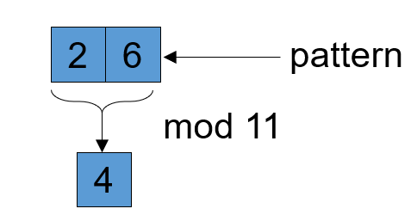
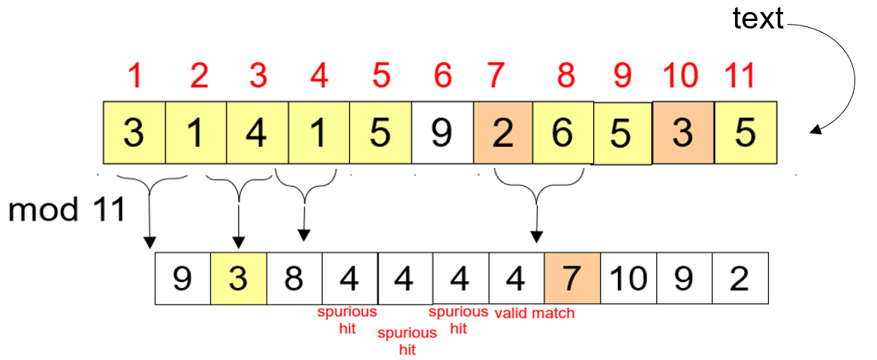
Rabin Karp Example1

Slide 31
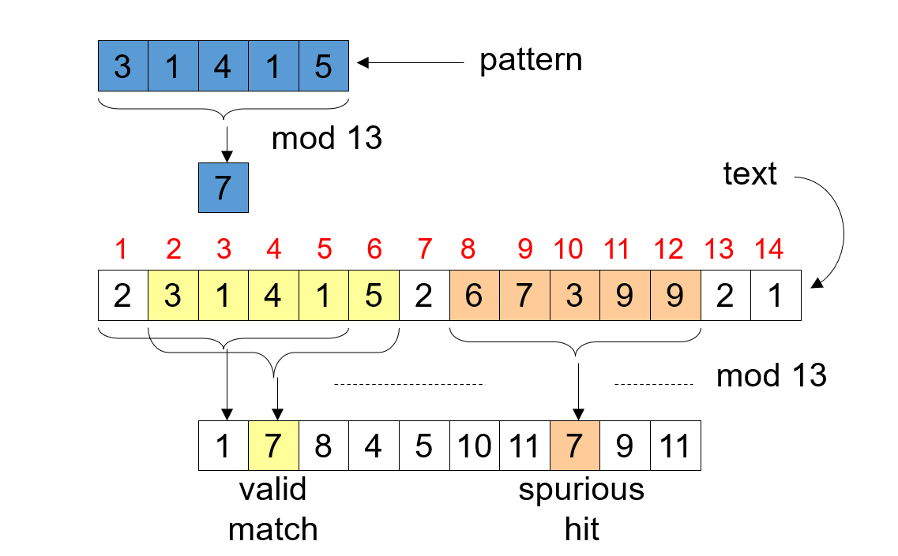
Rabin Karp Example2

Slide 32
Rabin-Karp Algorithm
Basic structure like the naïve algorithm, but uses modular arithmetic as described
For each hit, i.e., for each s where t_{s} ≡ p (mod q), verify character by character whether s is a valid shift or a spurious hit
In the worst case, every shift is verified
Running time can be shown as O((n-m+1)m)
Average-case running time is O(n+m)
If a mismatch occurs between the text and pattern P at P[j], what is the most we can shift the pattern to avoid wasteful comparisons?
Answer: the largest prefix of P[0 .. j-1] that is a suffix of P[1 .. j-1]

Slide 33
The KMP Algorithm
The Knuth-Morris-Pratt (KMP) algorithm looks for the pattern in the text in a left-to-right order (like the brute force algorithm).
But it shifts the pattern more intelligently than the brute force algorithm.

Slide 34
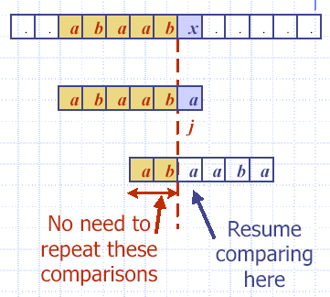
Example
T:
P:
j = 5
j_{new} = 2

Slide 35
Knuth-Morris-Pratt Algorithm
KMP-Search(T,P)
01 π ← Compute-Prefix-Table(P)
02 q ← 0 // number of characters matched
03 for i ← 0 to n-1 // scan the text from left to right
04 while q > 0 and P[q] ≠ T[i] do
05 q ← π[q]
06 if P[q] = T[i] then q ← q + 1
07 if q = m then return i – m + 1
08 return –1
Compute-Prefix-Table is the essentially the same KMP search algorithm performed on P.

Slide 36
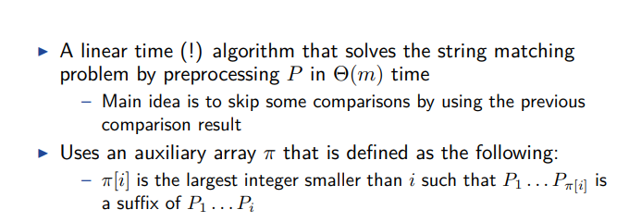
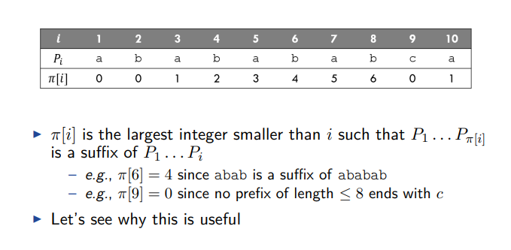
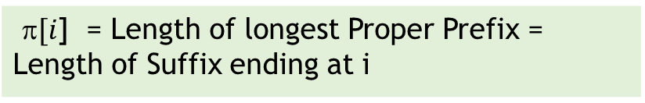
Prefix function
$[i$] = Length of longest Proper Prefix = Length of Suffix ending at i
A Proper prefix is a prefix with whole string not allowed. Eg: Prefix of “ABC” = “ ”, “A”, “AB”, “ABC” Proper Prefix of “ABC” = “ ”, “A”, “AB” Suffix of “ABC” = “ ”, “C”, “BC”, “ABC” Proper Suffix of “ABC” = “ ”, “C”, “BC”

Slide 37
KMP Advantages
KMP runs in optimal time: O(m+n)
very fast
The algorithm never needs to move backwards in the input text, T
this makes the algorithm good for processing very large files that are read in from external devices or through a network stream

Slide 38
KMP Disadvantages
KMP doesn’t work so well as the size of the alphabet increases
more chance of a mismatch (more possible mismatches)
mismatches tend to occur early in the pattern, but KMP is faster when the mismatches occur later

Slide 39
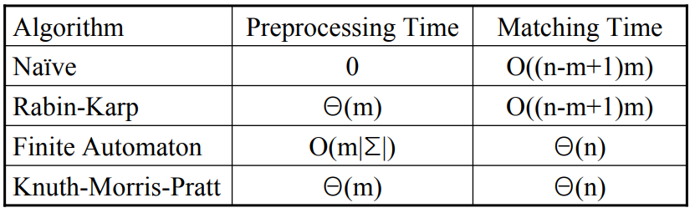
Analysis of KMP
Worst-case running time: O(n+m)
Main algorithm: O(n)
Compute-Prefix-Table: O(m)
Space usage: O(m)

Slide 40
KMP Algorithm – Prefix Table – Examples
A | A | A | A
0 | 1 | 2 | 3
A | A | A | B | A | A | A
0 | 1 | 2 | 0 | 1 | 2 | 3
A | A | B | A | A | C | A | A | B | A | A
0 | 1 | 0 | 1 | 2 | 0 | 1 | 2 | 3 | 4 | 5
a | b | a | b | a | b | a | b | c | a
0 | 0 | 1 | 2 | 3 | 4 | 5 | 6 | 0 | 1
A | A | A | C | A | A | A | A | A | C
0 | 1 | 2 | 0 | 1 | 2 | 3 | 3 | 3 | 4
B | A | B | A | B | A | C | B | B | A
0 | 0 | 1 | 2 | 3 | 4 | 0 | 1 | 1 | 2
Courtesy: https://cmps-people.ok.ubc.ca/ylucet/DS/KnuthMorrisPratt.html

Slide 41
KMP Algorithm – Prefix Table Examples – continued…
A | B | A | B | A | B | A | B | C | A
0 | 0 | 1 | 2 | 3 | 4 | 5 | 6 | 0 | 1
A | B | A | A | B | C | A | A | B
0 | 0 | 1 | 1 | 2 | 0 | 1 | 1 | 2
A | B | A | B | A | C | A
0 | 0 | 1 | 2 | 3 | 0 | 1
A | C | A | C | A | B | A | C | A | C | A | B | A | C | A | C | A | C
0 | 0 | 1 | 2 | 3 | 0 | 1 | 2 | 3 | 4 | 5 | 6 | 7 | 8 | 9 | 10 | 11 | 4

Slide 42
KMP Algorithm-Example1
1 | 2 | 3 | 4 | 5 | 6 | 7
a | b | c | d | a | b | d
0 | 0 | 0 | 0 | 1 | 2 | 0
1 | 2 | 3 | 4 | 5 | 6 | 7 | 8 | 9 | 10 | 11 | 12 | 13 | 14 | 15 | 16 | 17 | 18 | 19 | 20 | 21 | 22 | 23
a | b | c |  | a | b | c | d | a | b |  | a | b | c | d | a | b | c | d | a | b | d | e
a | b | c | d | a | b | d
Last match found at k=3, π[3]=0, Shift Pattern by k-π[k]=3 places ; 3-0=3, shift by 3 places
1 | 2 | 3 | 4 | 5 | 6 | 7 | 8 | 9 | 10 | 11 | 12 | 13 | 14 | 15 | 16 | 17 | 18 | 19 | 20 | 21 | 22 | 23
a | b | c |  | a | b | c | d | a | b |  | a | b | c | d | a | b | c | d | a | b | d | e
 |  |  | a | b | c | d | a | b | d
Mismatch at k=1, π[1]=0, shift Pattern, P by k-π[k]=1-0=1, shift by 1 place
NOTE: k represents total number of character matches occurred. It is used as index to the prefix table

Slide 43
KMP Algorithm-Example1
1 | 2 | 3 | 4 | 5 | 6 | 7 | 8 | 9 | 10 | 11 | 12 | 13 | 14 | 15 | 16 | 17 | 18 | 19 | 20 | 21 | 22 | 23
a | b | c |  | a | b | c | d | a | b |  | a | b | c | d | a | b | c | d | a | b | d | e
 |  |  |  | a | b | c | d | a | b | d
Last match found at k=6, π[6]=2, Shift Pattern, P by k-π[k]= 6-2=4 places
1 | 2 | 3 | 4 | 5 | 6 | 7 | 8 | 9 | 10 | 11 | 12 | 13 | 14 | 15 | 16 | 17 | 18 | 19 | 20 | 21 | 22 | 23
a | b | c |  | a | b | c | d | a | b |  | a | b | c | d | a | b | c | d | a | b | d | e
 |  |  |  |  |  |  |  | a | b | c | d | a | b | d
Last match found at k=2, π[2]=0, Shift Pattern, P by k-π[k]= 2-0=2 places
1 | 2 | 3 | 4 | 5 | 6 | 7 | 8 | 9 | 10 | 11 | 12 | 13 | 14 | 15 | 16 | 17 | 18 | 19 | 20 | 21 | 22 | 23
a | b | c |  | a | b | c | d | a | b |  | a | b | c | d | a | b | c | d | a | b | d | e
 |  |  |  |  |  |  |  |  |  | a | b | c | d | a | b | d
Mismatch at k=1, π[1]=0, shift Pattern, P by k-π[k]=1-0=1, shift by 1 place

Slide 44
KMP Algorithm-Example1
1 | 2 | 3 | 4 | 5 | 6 | 7 | 8 | 9 | 10 | 11 | 12 | 13 | 14 | 15 | 16 | 17 | 18 | 19 | 20 | 21 | 22 | 23
a | b | c |  | a | b | c | d | a | b |  | a | b | c | d | a | b | c | d | a | b | d | e
 |  |  |  |  |  |  |  |  |  |  | a | b | c | d | a | b | d
Last match found at k=6, π[6]=4, Shift Pattern, P by k-π[k]= 6-2=4 places
1 | 2 | 3 | 4 | 5 | 6 | 7 | 8 | 9 | 10 | 11 | 12 | 13 | 14 | 15 | 16 | 17 | 18 | 19 | 20 | 21 | 22 | 23
a | b | c |  | a | b | c | d | a | b |  | a | b | c | d | a | b | c | d | a | b | d | e
 |  |  |  |  |  |  |  |  |  |  |  |  |  |  | a | b | c | d | a | b | d
All 7 letters are matched, shift by k-π[k]= 7-π[7]=7-0=7 places

Slide 45
KMP Algorithm-Example2
1 | 2 | 3 | 4 | 5 | 6
a | b | c | a | b | y
0 | 0 | 0 | 1 | 2 | 0
1 | 2 | 3 | 4 | 5 | 6 | 7 | 8 | 9 | 10 | 11 | 12
a | b | x | a | b | c | a | b | c | a | b | y
a | b | c | a | b | y
Last match found at k=2, π[2]=0. Shift Pattern, P by k-π[k]=2-0=2, shift by 2 places
1 | 2 | 3 | 4 | 5 | 6 | 7 | 8 | 9 | 10 | 11 | 12 | 13 | 14 | 15 | 16 | 17 | 18 | 19 | 20 | 21 | 22 | 23
a | b | c |  | a | b | c | d | a | b |  | a | b | c | d | a | b | c | d | a | b | d | e
 |  | a | b | c | a | b | y
Mismatch at k=1, π[1]=0, shift Pattern, P by k-π[k]=1-0=1, shift by 1 place

Slide 46
KMP Algorithm-Example2
1 | 2 | 3 | 4 | 5 | 6
a | b | c | a | b | y
0 | 0 | 0 | 1 | 2 | 0
1 | 2 | 3 | 4 | 5 | 6 | 7 | 8 | 9 | 10 | 11 | 12
a | b | x | a | b | c | a | b | c | a | b | y
 |  |  | a | b | c | a | b | y
Last match found at k=5, π[5]=2. Shift Pattern, P by k-π[k]=5-2=3, shift by 3 places
1 | 2 | 3 | 4 | 5 | 6 | 7 | 8 | 9 | 10 | 11 | 12
a | b | x | a | b | c | a | b | c | a | b | y
 |  |  |  |  |  | a | b | c | a | b | y
All 6 letters are matched

Slide 47
KMP Algorithm-Example3
1 | 2 | 3 | 4 | 5 | 6 | 7 | 8 | 9
a | b | a | b | c | a | b | a | b
0 | 0 | 1 | 2 | 0 | 1 | 2 | 3 | 4
1 | 2 | 3 | 4 | 5 | 6 | 7 | 8 | 9 | 10 | 11 | 12 | 13 | 14 | 15 | 16 | 17 | 18 | 19
a | b | a | b | d | a | b | a | c | d | a | b | a | b | c | a | b | a | b
a | b | a | b | c | a | b | a | b
Last match occurred at k=4, π[4]=2. Shift Pattern, P by k-π[k]=4-2=2, shift by 2 places
1 | 2 | 3 | 4 | 5 | 6 | 7 | 8 | 9 | 10 | 11 | 12 | 13 | 14 | 15 | 16 | 17 | 18 | 19
a | b | a | b | d | a | b | a | c | d | a | b | a | b | c | a | b | a | b
 |  | a | b | a | b | c | a | b | a | b
Last match occurred at k=2, π[2]=0. Shift Pattern, P by k-π[k]=2-0=2, shift by 2 places

Slide 48
KMP Algorithm-Example3
1 | 2 | 3 | 4 | 5 | 6 | 7 | 8 | 9
a | b | a | b | c | a | b | a | b
0 | 0 | 1 | 2 | 0 | 1 | 2 | 3 | 4
1 | 2 | 3 | 4 | 5 | 6 | 7 | 8 | 9 | 10 | 11 | 12 | 13 | 14 | 15 | 16 | 17 | 18 | 19
a | b | a | b | d | a | b | a | c | d | a | b | a | b | c | a | b | a | b
 |  |  |  | a | b | a | b | c | a | b | a | b
Last match occurred at k=1, π[1]=0, shift Pattern, P by k-π[k]=1-0=1, shift by 1 place
1 | 2 | 3 | 4 | 5 | 6 | 7 | 8 | 9 | 10 | 11 | 12 | 13 | 14 | 15 | 16 | 17 | 18 | 19
a | b | a | b | d | a | b | a | c | d | a | b | a | b | c | a | b | a | b
 |  |  |  |  | a | b | a | b | c | a | b | a | b
Last match occurred at k=3, π[3]=1, shift Pattern, P by k-π[k]=3-1=2, shift by 2 places
1 | 2 | 3 | 4 | 5 | 6 | 7 | 8 | 9 | 10 | 11 | 12 | 13 | 14 | 15 | 16 | 17 | 18 | 19
a | b | a | b | d | a | b | a | c | d | a | b | a | b | c | a | b | a | b
 |  |  |  |  |  |  | a | b | a | b | c | a | b | a | b
Last match occurred at k=1, π[1]=0, shift Pattern, P by k-π[k]=1-0=1, shift by 1 place

Slide 49
KMP Algorithm-Example3
1 | 2 | 3 | 4 | 5 | 6 | 7 | 8 | 9
a | b | a | b | c | a | b | a | b
0 | 0 | 1 | 2 | 0 | 1 | 2 | 3 | 4
1 | 2 | 3 | 4 | 5 | 6 | 7 | 8 | 9 | 10 | 11 | 12 | 13 | 14 | 15 | 16 | 17 | 18 | 19
a | b | a | b | d | a | b | a | c | d | a | b | a | b | c | a | b | a | b
 |  |  |  |  |  |  |  | a | b | a | b | c | a | b | a | b
Last match occurred at k=1, π[1]=0, shift Pattern, P by k-π[k]=1-0=1, shift by 1 place
1 | 2 | 3 | 4 | 5 | 6 | 7 | 8 | 9 | 10 | 11 | 12 | 13 | 14 | 15 | 16 | 17 | 18 | 19
a | b | a | b | d | a | b | a | c | d | a | b | a | b | c | a | b | a | b
 |  |  |  |  |  |  |  |  | a | b | a | b | c | a | b | a | b
Last match occurred at k=1, π[1]=0, shift Pattern, P by k-π[k]=1-0=1, shift by 1 place
1 | 2 | 3 | 4 | 5 | 6 | 7 | 8 | 9 | 10 | 11 | 12 | 13 | 14 | 15 | 16 | 17 | 18 | 19
a | b | a | b | d | a | b | a | c | d | a | b | a | b | c | a | b | a | b
 |  |  |  |  |  |  |  |  |  | a | b | a | b | c | a | b | a | b
Pattern found at position 11 in the text

Slide 50
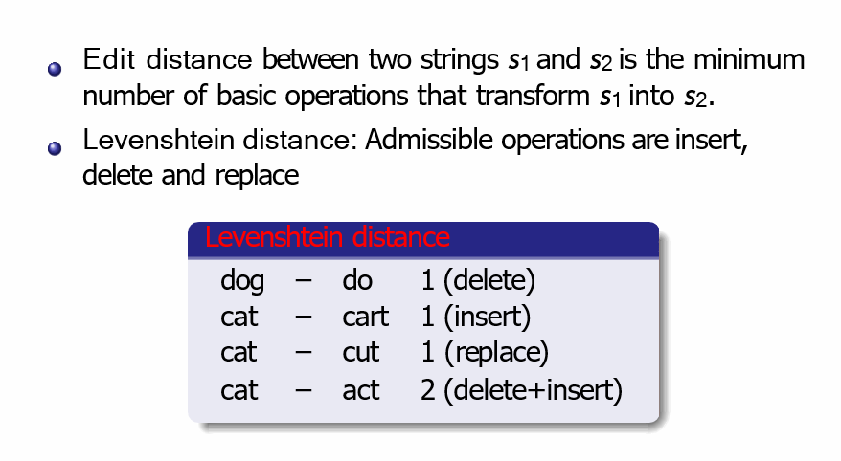
Edit Distance

Slide 51
Dynamic Programming
Cormen et al:
Optimal substructure: The optimal solution contains within it subsolutions, i.e, optimal solutions to subproblems
Overlapping subsolutions: The subsolutions overlap and would be computed over and over again by a brute-force algorithm.
For edit distance:
Subproblem: edit distance of two prefixes
Overlap: most distances of prefixes are needed 3 times (when moving right, diagonally, down in the matrix)

Slide 52
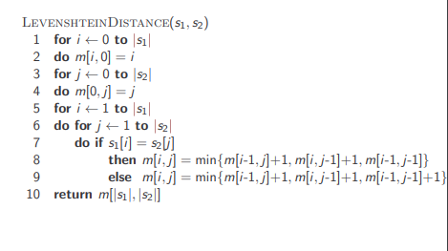
Levenshtein distance:Algorithm

Slide 53
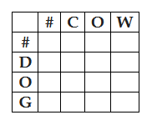
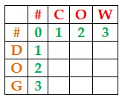
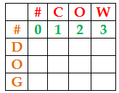
Example1
Step 1: Draw the edit distance matrix. In this, each word is preceded by # symbol which marks the empty string.
Step 2: Find the edit-distance values using minimum edit distance algorithm to convert # (row side) to #COW (column side) and populate appropriate cells with the calculated distance.
Number of operations required to convert;
• # to # is 0.
• # to #C is 1. That is, one insertion (no change with #, insert C)
• # to #CO is 2. That is, two insertions (no change with #, insert C and O)
• # to #COW is 3. That is, three insertions (no change with #, insert C, O and W)
Step 3: Find the edit-distance values using minimum edit distance algorithm to convert # (column side) to #DOG (row side) and populate appropriate cells with the calculated distance.
Number of operations required to convert
• # to # is 0.
• # to #D is 1. [one insertion (no change with #, insert D]
• # to #DO is 2. [two insertions (no change #, insert D and O]
• # to #DOG is 3. [three insertions (no change #, insert D, O and G]
So far, we have found the minimum edit distance for 7 sub-problems.
[# - # = 0, # - #C = 1, # - #CO = 2, # - #COW = 3, # - #D = 1, # - #DO = 2, and # - #DOG = 3]

Slide 54
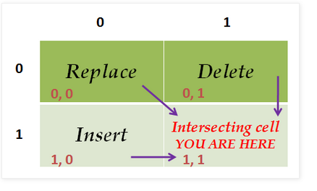
Example
Step 4: From this step onwards, we try to find the cost for a sub-problem by finding the minimum cost of three sub-problems and add 1 with that if the characters intersect at that cell are different.
If the intersecting characters are same, then we add 0 with the diagonal cell value.
Note: we have used A as the name for this matrix and included the index numbers for easy understanding]
Use the following table as a key to find the cost.

Slide 55
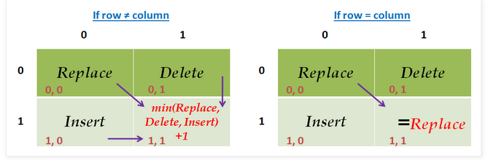
Example
If the row character ≠ column character,
The cost of the intersecting cell = min(replace, delete, insert) + 1.
If the row character = column character,
The cost of the intersecting cell = cost of the Replace cell

Slide 56
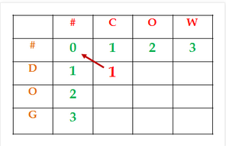
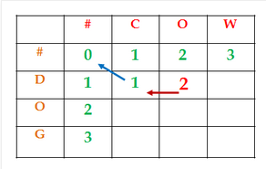
Sub-problem: #D ➔ #C.
Intersecting cell: A[1, 1]
Same intersecting characters? NO.
Cost(A[1, 1]) = Min(A[0, 0], A[0, 1], A[1, 0]) + 1
= Min(0, 1, 1) + 1
= 0 + 1 = 1
As the cost derived from the cost of cell A[0, 0], a pointer is included from the current cell A[1, 1] to mark the back-trace path.
Sub-problem: #D ➔ #CO.
Intersecting cell: A[1, 2]
Same intersecting characters? NO.
Cost(A[1, 2]) = Min(A[0, 1], A[0, 2], A[1, 1]) + 1
= Min(1, 2, 1) + 1
= 1 + 1 = 2
As the cost derived from the cost of cell A[1, 1], a pointer is included from the current cell A[1, 2] to mark the back-trace path.

Slide 57
Example1
Justification for choosing cell A[1, 1] as the previous cell:
We have two cells (A[0,1] and A[1, 1]) with the same minimum cost 1. Which one to choose? We choose A[1, 1]. The reasons are;
We are trying to convert ‘D’ to ‘CO’ in this sub-problem
We already used the substitution operation (substitute character D with C).
So, the next character ‘O’ in the output can be derived with the insert operation only.
Hence, we have chosen the cell A[1, 1] which represents insert operation (refer the key table above) as the minimum valued cell

Slide 58
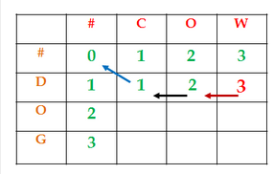
Sub-problem: #D ➔ #COW.
Intersecting cell: A[1, 3]
Same intersecting characters? NO.
Cost(A[1, 3]) = Min(A[0, 2], A[0, 3], A[1, 2]) + 1
=Min(2, 3, 2) + 1
= A[1, 2] + 1
= 2 + 1 = 3
As the cost derived from the cost of cell A[1, 2], a pointer is included from the current cell A[1, 3] to mark the back-trace path.
Justification for choosing cell A[1, 2] as the previous cell: We have two cells (A[0, 2] and A[1, 2]) with the same minimum cost 1. Which one to choose? We choose A[1, 2]. The reasons are;
We are trying to convert ‘D’ to ‘COW’ in this sub-problem
We already used the substitution operation (substitute character D with C).
So, the next characters ‘O’ and ‘W’ in the output can be derived with the insert operation only.
Hence, we have chosen the cell A[1, 2] which represents insert operation (refer the key table above) as the minimum valued cell.

Slide 59
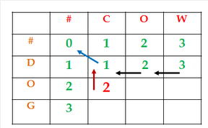
Sub-problem: #DO ➔ #C.
Intersecting cell: A[2, 1]
Same intersecting characters? NO.
Cost(A[2, 1]) = Min(A[1, 0], A[1, 1], A[2, 0]) + 1
=Min(1, 1, 2) + 1
= A[1, 1] + 1
= 1 + 1 = 2
As the cost derived from the cost of cell A[1, 1], a pointer is included from the current cell A[2, 1] to mark the back-trace path.
Justification for choosing cell A[1, 1] as the previous cell: We have two cells (A[1, 0] and A[1, 1]) with the same minimum cost 1. Which one to choose? We choose A[1, 1]. The reasons are;
We are trying to convert ‘DO’ to ‘C’ in this sub-problem
We already used the substitution operation (substitute character D with C).
So, the next character ‘O’ has to be removed in the output. Hence, a delete operation used.
Hence, we have chosen the cell A[1, 1] which represents delete operation (refer the key table above) as the minimum valued cell.

Slide 60
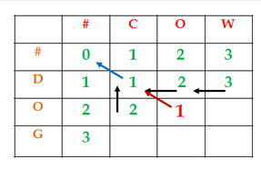
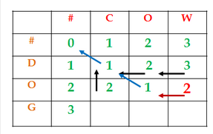
Sub-problem: #DO ➔ #CO.
Intersecting cell: A[2, 2]
Same intersecting characters? YES
Cost(A[2, 2]) = Min(A[1, 1], A[1, 2], A[2, 1]) + 0
=Min(1, 2, 2)
= A[1, 1] + 0
= 1 + 0 = 1
As the cost derived from the cost of cell A[1, 1], a pointer is included from the current cell A[2, 2] to mark the back-trace path.
Sub-problem: #DO ➔ #COW.
Intersecting cell: A[2, 3]
Same intersecting characters? NO.
Cost(A[2, 3]) = Min(A[1, 2], A[1, 3], A[2, 2]) + 1
=Min(2, 3, 1)
= A[2, 2] + 1
= 1 + 1 = 2
As the cost derived from the cost of cell A[2, 2], a pointer is included from the current cell A[2, 3] to mark the back-trace path.

Slide 61
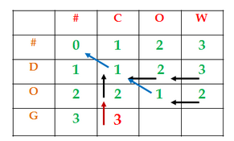
Sub-problem: #DOG ➔ #C.
Intersecting cell: A[3, 1]
Same intersecting characters? NO.
Cost(A[3, 1]) = Min(A[2, 0], A[2, 1], A[3, 0]) + 1
=Min(2, 2, 3) + 1
= A[2, 1] + 1
= 2 + 1 = 3
Justification for choosing cell A[3, 1] as the previous cell: We have two cells (A[2, 0] and A[2, 1]) with the same minimum cost 1. Which one to choose? We choose A[2, 1]. The reasons are;
We are trying to convert ‘DOG’ to ‘C’ in this sub-problem
We already used the substitution operation (substitute character D with C) and delete operation (deleted a character ‘O’). [refer sub-problem #DO → #C]
So, the next character ‘G’ has to be removed in the output as well. Hence, a delete operation used.
Hence, we have chosen the cell A[2, 1] which represents delete operation (refer the key table above) as the minimum valued cell.

Slide 62
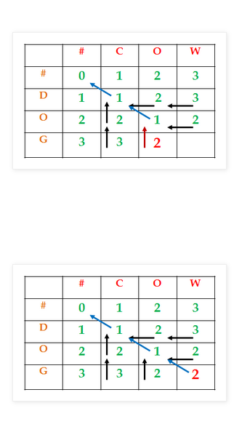
Sub-problem: #DOG ➔ #CO.
Intersecting cell: A[3, 2]
Same intersecting characters? NO
Cost(A[3, 2]) = Min(A[2, 1], A[2, 2], A[3, 1]) + 1
= A[2, 2] + 1
= 1 + 1 = 2
Sub-problem: #DOG ➔ #COW.
Intersecting cell: A[3, 3]
Same intersecting characters? NO.
Cost(A[3, 3]) = Min(A[2, 2], A[2, 3], A[3, 2]) + 1
= A[2, 2] + 1
= 1 + 1 = 2

Slide 63
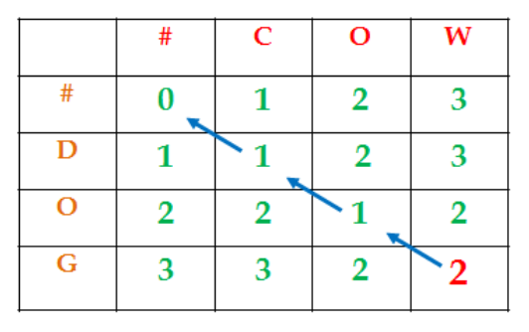
Now, to learn the alignment, we need to traverse back from the last cell (the minimum edit distance between DOG and COW) using the pointer that starts at that cell. Refer the image below;
The cost at cell A[3, 3] was derived from cell A[2, 2] by incrementing the cost at A[2, 2] due to the substitution operation.
The cost at cell A[2, 2] was derived from cell A[1, 1]. The cost of A[1, 1] is used as it is because of No change. (the column character = row character in the intersecting cell).
The cost at cell A[1, 1] was derived from cell A[0, 0] by incrementing the cost at A[0, 0] due to the substitution operation.

Slide 64
Hence, the result of Minimum Edit Distance with alignment is;
D | O | G
| | | | |
C | O | W
Substitution | No change | Substitution

Slide 65
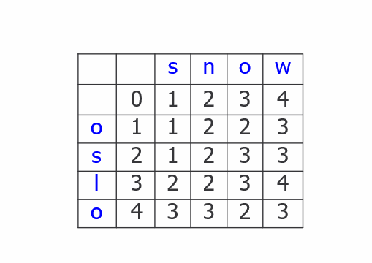
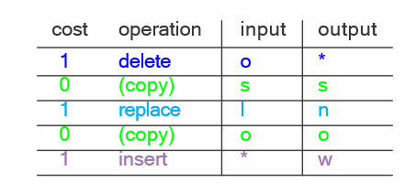
Levenshtein distance: Example 2

Slide 66
References
https://www.geeksforgeeks.org/rabin-karp-algorithm-for-pattern-searching/

